Slide 1
PHARMATECH

Slide 2
TABLE OF CONTENTS
Problem/Opportunity
01
Solution
02
Target Audience
03
Value Proposition
04
Defines the challenge or potential to achieve goals.
Defines how the problem will be solved or the opportunity leveraged.
Identifies the specific group intended to benefit from the solution.
Highlights the unique benefits and value offered to the target audience.

Slide 3
Problem/Opportunity
01
Defines the challenge or potential to achieve goals.

Slide 4

Problem/Opportunity
A
Medication Shortage
There is a shortage of essential medications, causing difficulty in meeting patients' needs.
B
Prescription Misreading
Pharmacists struggle to read prescriptions, causing dispensing errors.
C
Finding Pharmacies Nearby
People face challenges in locating the nearest pharmacy, particularly in unfamiliar locations.
B
Allergy Test Neglect
Doctors may forget to advise allergy tests before medication.
A
Price Confusion
People face challenges in locating the nearest pharmacy, particularly in unfamiliar locations.

Slide 5
Solutions
02
Defines how the problem will be solved or the opportunity leveraged.

Slide 6
Solution of these Problems
Medication Shortage
Prescription Misreading
Finding Pharmacies Nearby
Allergy Test Neglect
Price Confusion
“We allow users to donate surplus medication in exchange for points, which can be redeemed for discounts or free meds.”
“The pharmacist scans the prescription, and AI converts the handwriting into clear digital text, reducing errors.”
“If someone is in an unfamiliar location, they can set their current location, and the system will show the nearest pharmacies.”
“A system that reminds doctors to recommend allergy tests before prescribing medication to avoid negative reactions.”
“Users can check medication prices in advance, ensuring they know the cost before visiting the pharmacy.”

Slide 7
03
Target Audience
The target audience is the specific group of people a product or message is designed to reach.

Slide 8


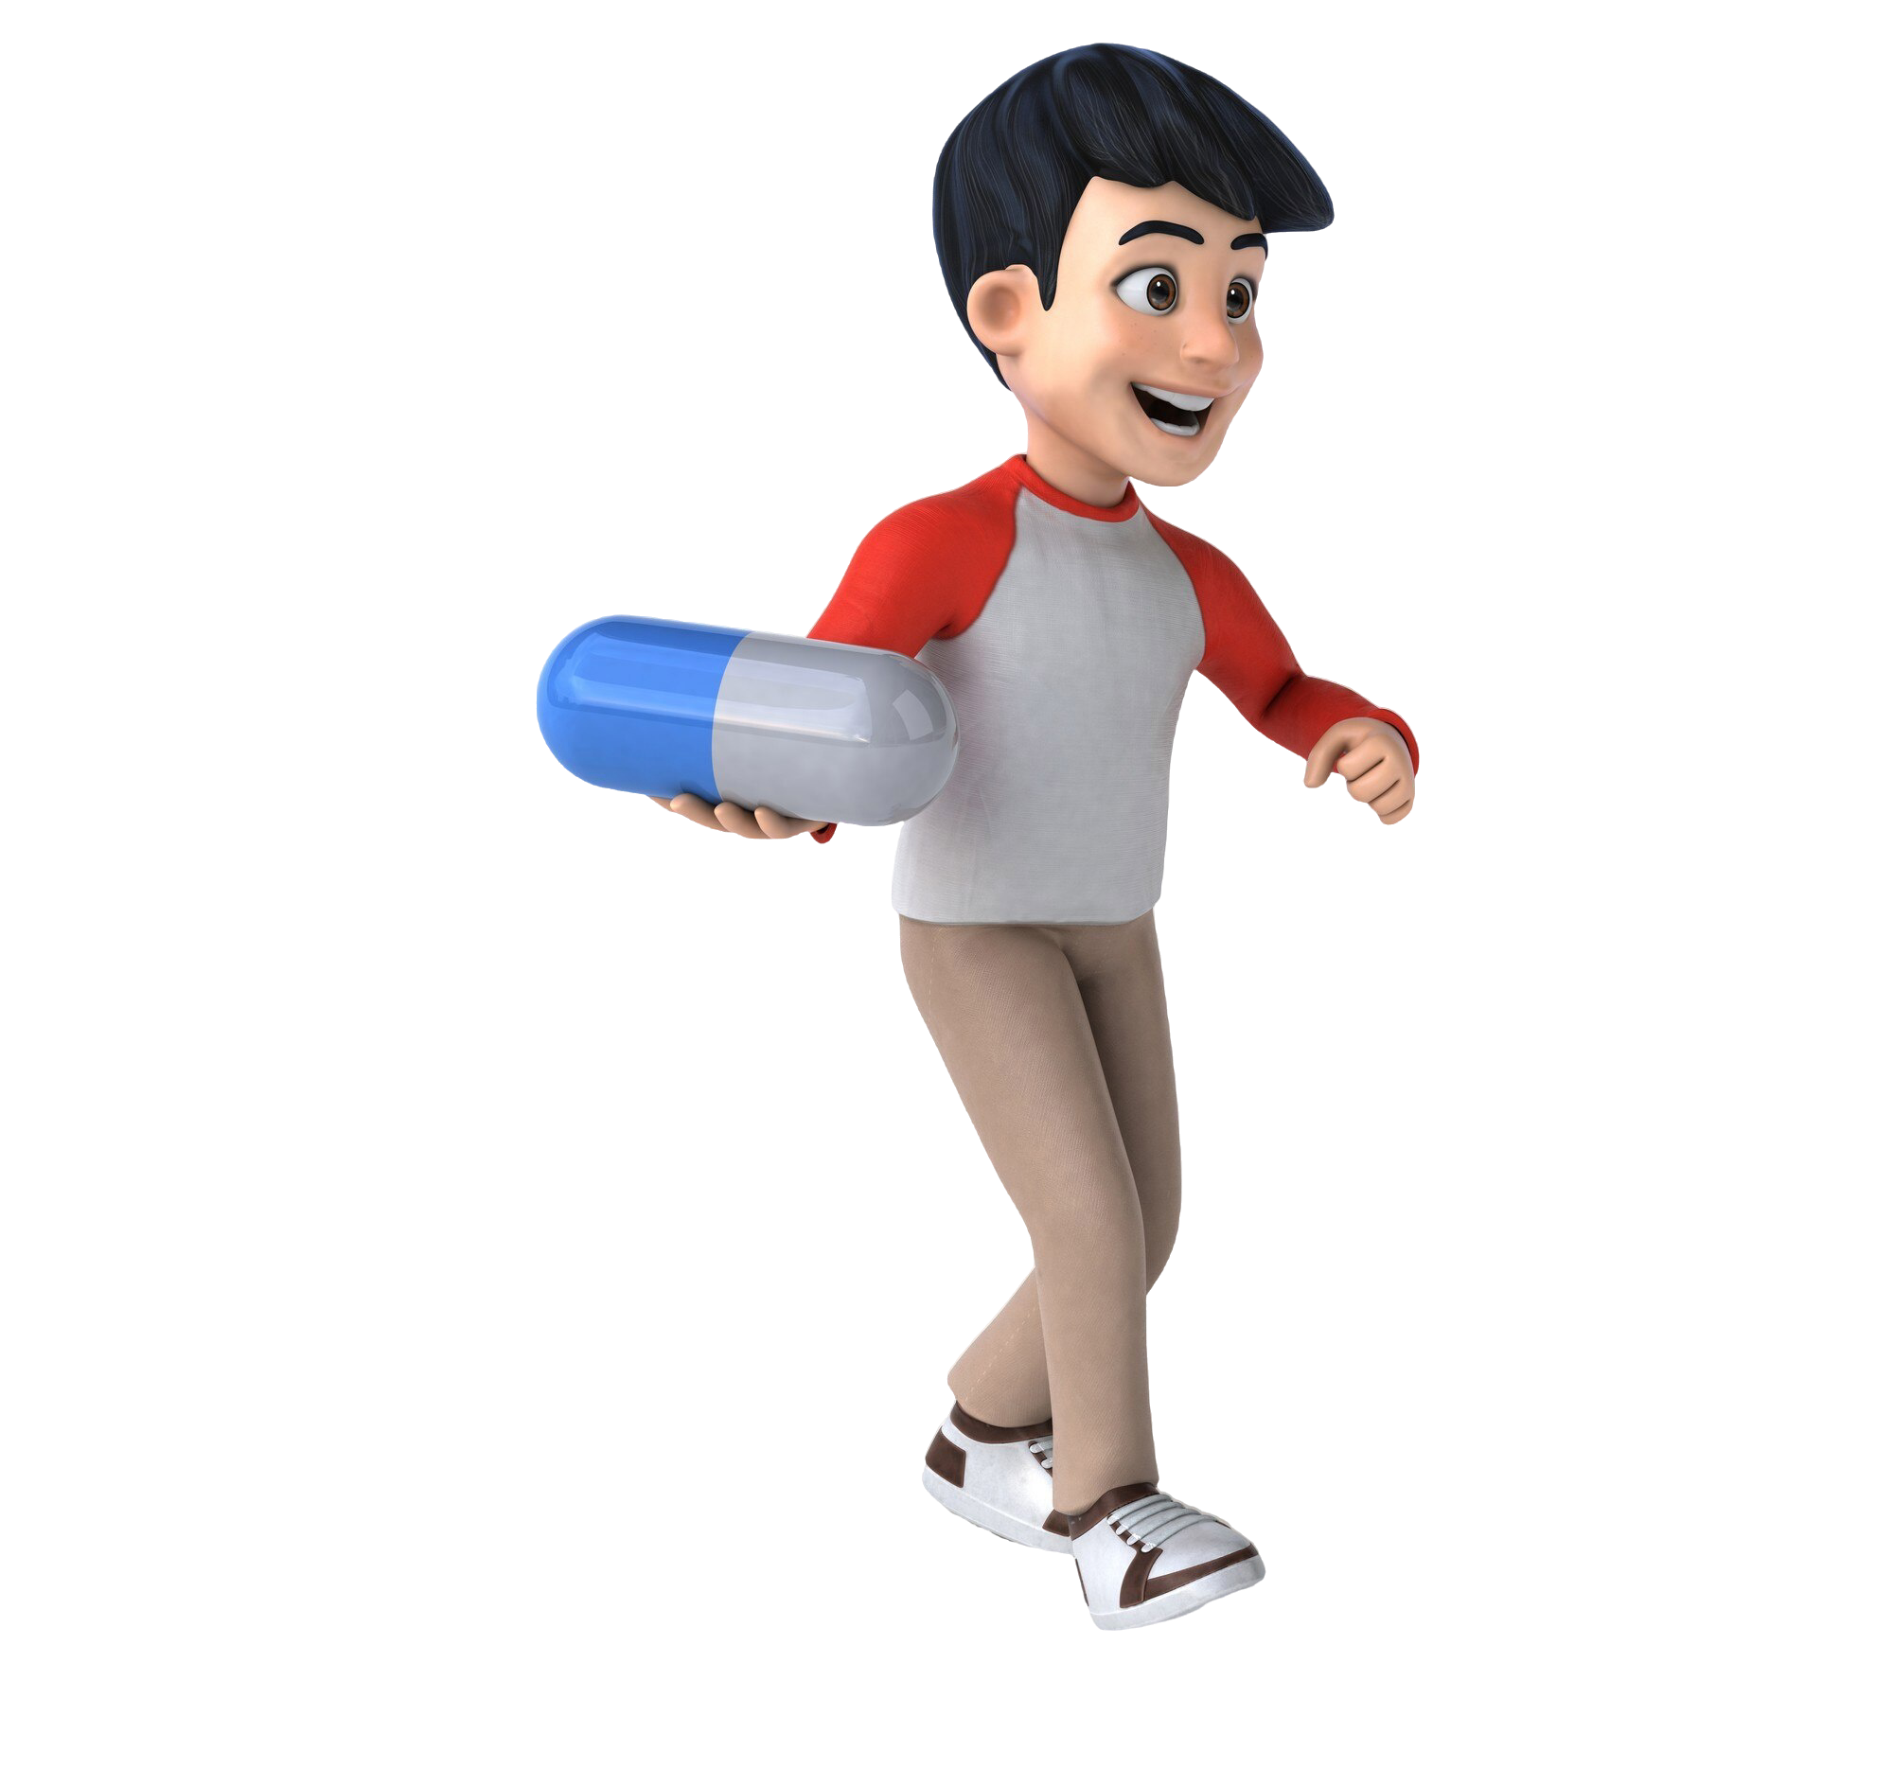
pharmacist
User (Patient)
Prescription Misreading
Allergy Test Neglect
Finding Pharmacies Nearby
Finding Pharmacies Nearby
Medication Shortage
Allergy Test Neglect
Price Confusion

Slide 9
04
Value Proposition
specific group of people a product or message is designed to reach.

Slide 10
Value Proposition
01
02
03
Medication Shortage
Prescription Misreading
Price Confusion
04
05
Allergy Test Neglect
Finding Pharmacies Nearby
User: Donate unused meds for points, redeemable for discounts/free meds.
Pharmacist: AI scans prescriptions, reducing errors and ensuring accuracy.
User: Check prices in advance, avoid surprises. Pharmacist: Provide accurate prices, improve satisfaction.
User: Reminders for allergy tests to prevent adverse reactions. Pharmacist: Helps doctors ensure safety.
User: Find nearest pharmacy quickly. Pharmacist: Know competitors’ locations to guide customers.

Slide 11
Thank You

